Slide 1
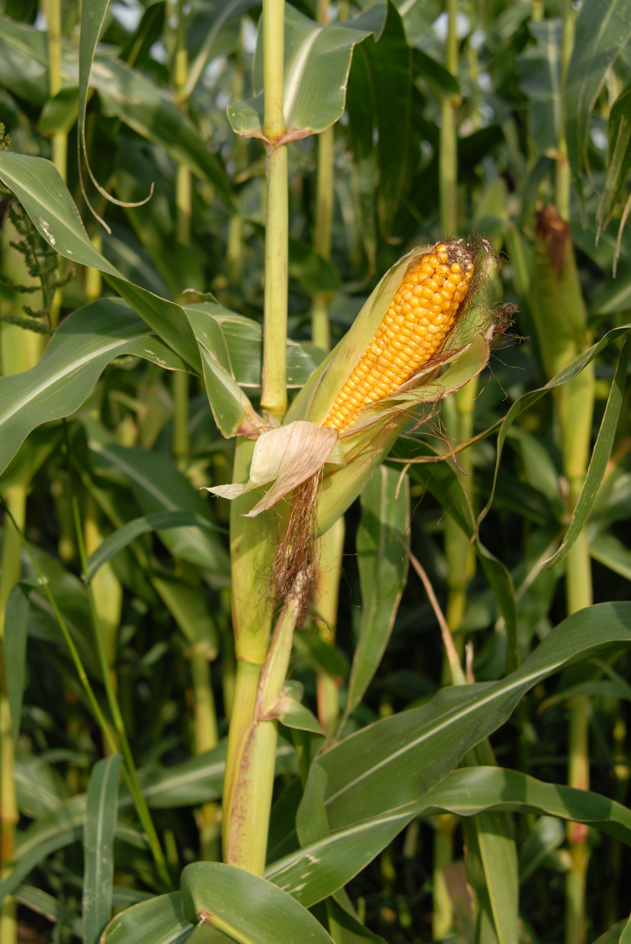
CONVOLUTIONAL NEURAL NETWORKS ALGORITHM
IMAGE-BASED CORN DISEASE IDENTIFIER
MARTE, MARK RJ
MS. JANNIE FLEUR V. ORAÑO
ADVISER

Slide 2
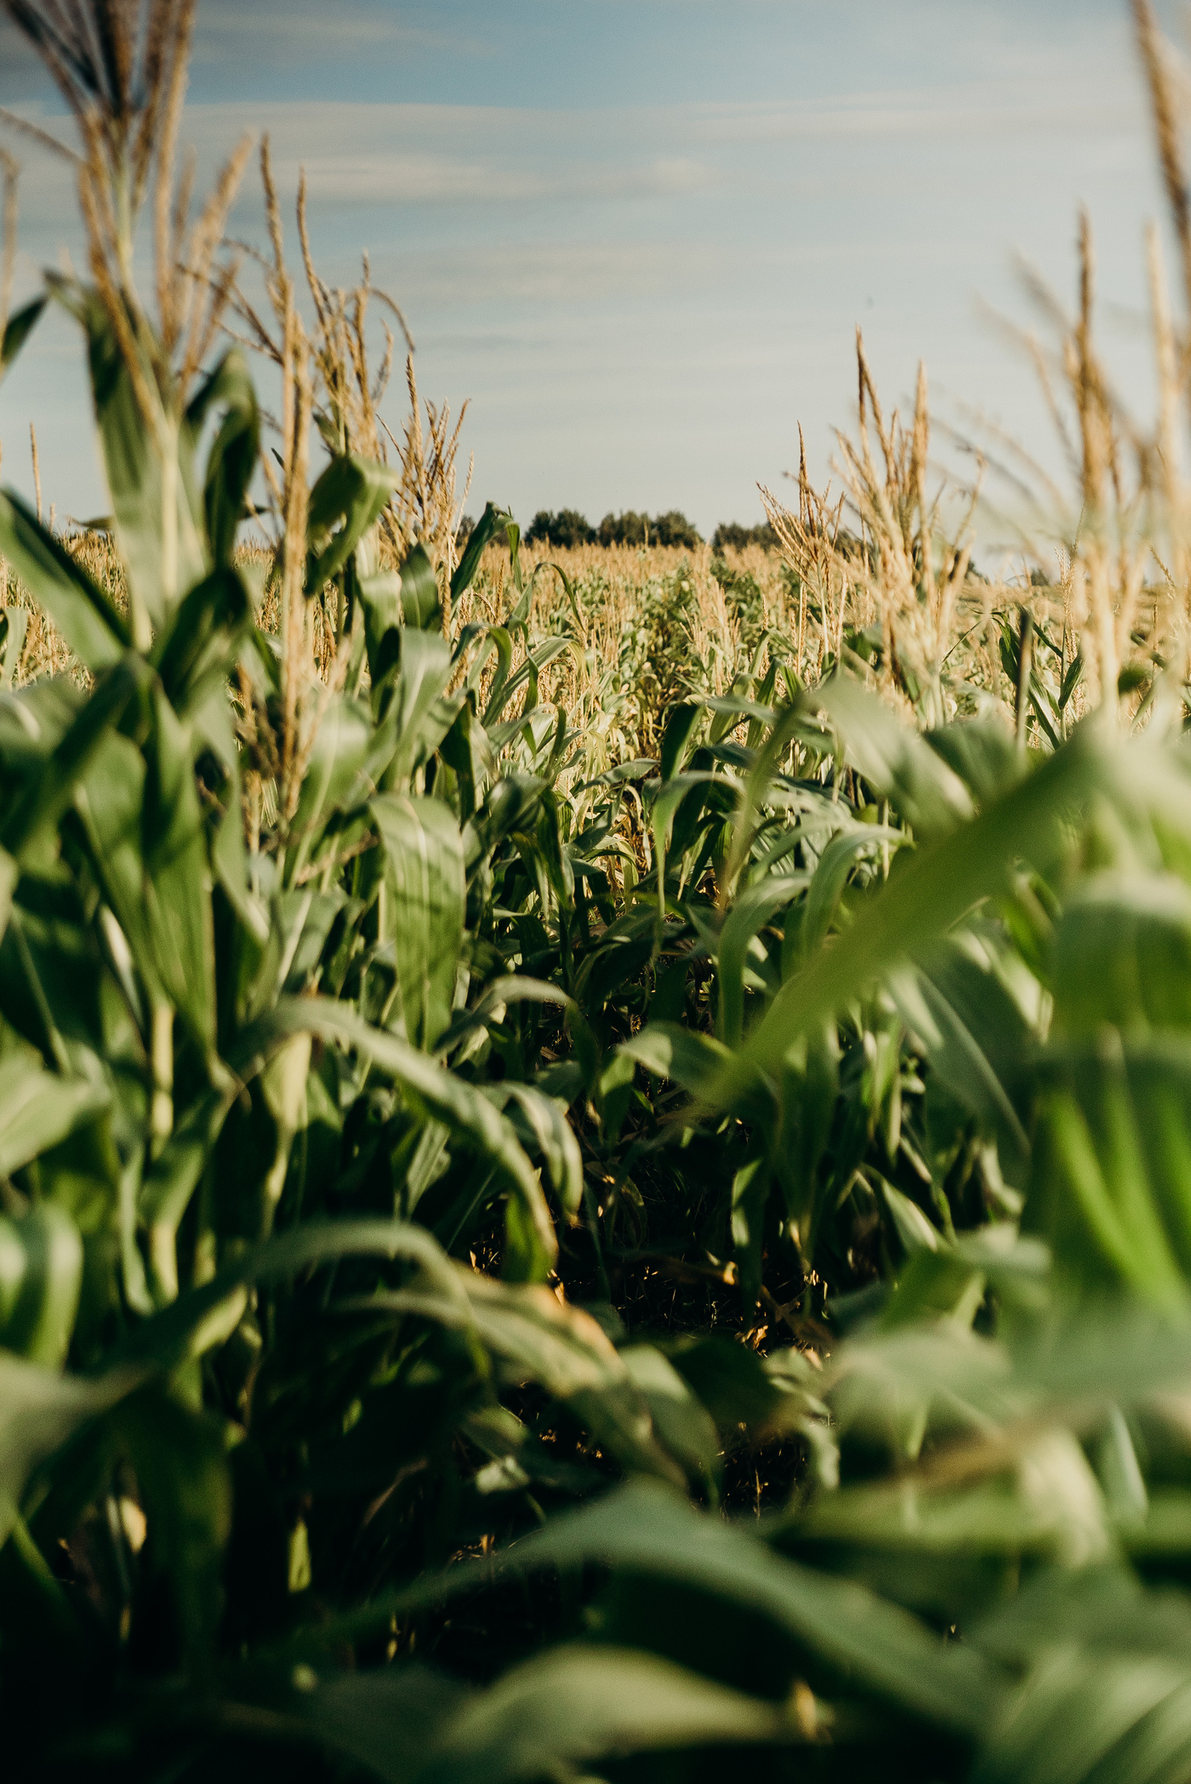
CHAPTER 1
INTRODUCTION

Slide 3
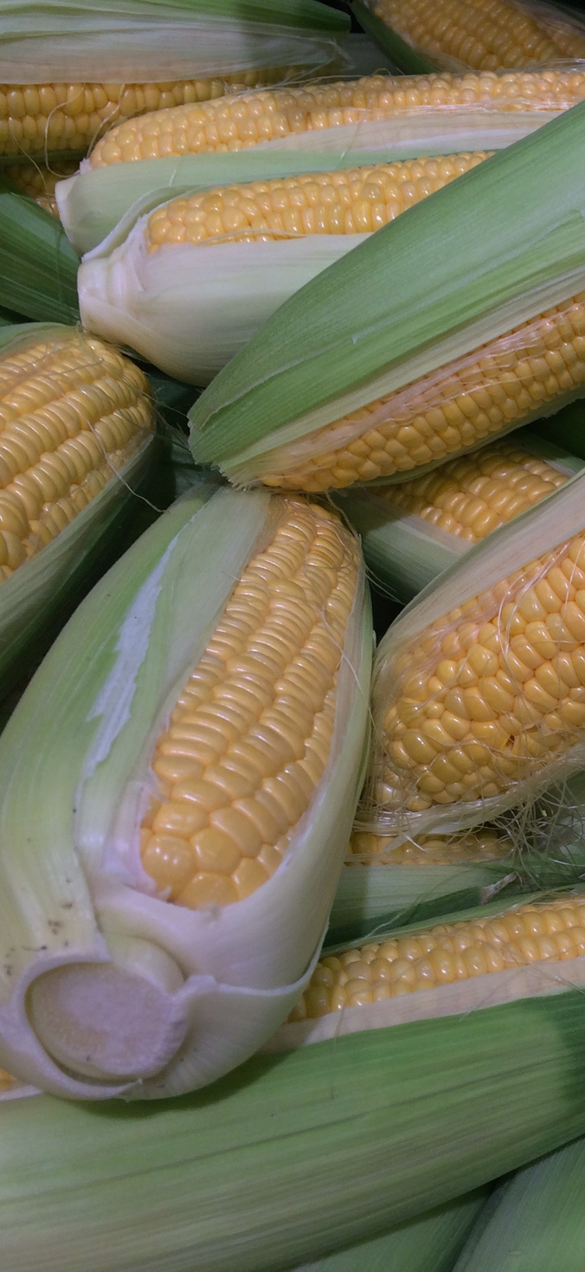
Corn is a tall annual cereal grass (Zea mays) that is widely grown for its large elongated ears of starchy seeds. The seeds, which are also known as corn, are used as food for humans and livestock, and as a source of biofuel and can be processed into a wide range of useful chemicals (Britannica, 2019).
1.1 PROJECT CONTENT
Corn was developed over years through a selective breeding process. As of today, corn is one of the most important food crops in the world where it provides more food, energy, and carbohydrates than any other food crops. Corn was cultivated on more land area than any other commercial food crops on the planet, (Gardening Channel, 2021).

Slide 4
According to Statista Research Department in the Philippines, corn production was based on the landscape and topography of an area. In 2020, maize production of the Philippines was 8,368 tons. Maize production in the Philippines increased from 2,013 tons in 1971 to 8,368 tons in 2020 growing at an average annual rate of 3.41% (Knoema, 2021).
1.1 PROJECT CONTENT
The Agriculture Sector is barring any major natural calamities. It is expected to grow 2.5% this year, on the back of stronger production in major agricultural commodities, such as corn, and high-value crops. These commodities comprise more than 70% of the country’s agricultural GVA.

Slide 5
Production and exportation help to stimulate the economy of the country where most of it, including other countries’ economy are dependent on agriculture – either in a small or big way, and that, corn contributes to the economic growth of the Philippines.
1.1 PROJECT CONTENT
In addition, the Agriculture Sector faced major challenges last year in corn crop, high diseases incidence has been reported in many parts of the country. Philippines was considered as the most virulent of the downy mildew pathogen affecting maize, causing substantial losses to crop production (Murray 2009).

Slide 6
With the development of technology, the use of deep learning and image recognition technology for plant disease detection has become an important research direction. In this study, implementing a suitable and fast identification system with machine learning can solve the gap in identifying and classifying the wide variety of corn diseases from images of plant leaves.
1.1 PROJECT CONTENT
The identification model focused on using class labels for training images, and built a fine-grained image classification system- a recognition method for corn disease images. Hence, this proposed system is using a novel method for identifying the diseases of corn plants using their images. This research is mainly focused on identifying the variety of corn diseases.

Slide 7
Image-based corn disease identifier is an innovative technology used in agriculture to solve the issues associated with all existing corn disease detection approaches. The image-based corn disease identifier delivers a more accurate and faster result, which aids in disease control. As a result, this study aids farmers in preventing, managing, and distinguishing a range of maize illnesses in a short amount of time.
1.2 PURPOSE AND DESCRIPTION OF THE PROJECT
The project's proponents are tasked with gathering existing data sets of corn disease photos, which will be used to train the system so that it can recognize a range of maize diseases. The system will accept an image from the user that will be subjected to object detection, which will identify all corn illnesses seen in the image. This initiative aims to identify several types of corn disease. We will use image processing to create an algorithm that will detect all of the corn disease in the provided image and identify it individually.

Slide 8
The proponents of this project aimed to develop a system that is capable of identifying a corn disease from an image. Specifically, this project intends to attain the following purposes:
1.3 OBJECTIVE OF THE PROJECT
To implement Deep Learning algorithm for training the classification model, To design and develop a user-friendly Graphical User Interface for Image-Based Corn Disease To evaluate the accuracy of the system in identifying a variety of corn disease.

Slide 9
his project is solely focused on identifying a corn disease. As a result, the system can only identify diseases that affect corn crops. The system in this study can only recognize corn diseases that were included during the classification model's training. Furthermore, the system will only allow one image to be processed at a time and will not enable two or more photographs to be processed at the same time. The system's design and development will take place during the first semester of the school year 2021-2022.
1.4 SCOPE AND LIMITATIONS OF THE PROJECT

Slide 10
CHAPTER 2
REVIEW OF RELATED LITERATURE

Slide 11
Machine learning techniques have been successful in identification and classification of wide variety of maize diseases from images of plant leaves (P. Rajendrakumar, 2016). Improvements in deep learning techniques in recent years have made them the state of the art among various computer vision approaches for image classification. Traditional computer vision approach for plant disease detection requires manual selection of features in making classification decisions (Shrinivas D. Desai, 2019), (Pooja Khanna, 2017).
2.1 RELATED LITERATURE/ THEORETICAL BACKGROUND
Meanwhile, Deep convolutional neural networks automatically learn most important features by multilayer processing of visual input. Significant prior work in the relevant area includes field imagery based deep neural network by De Chant et al for northern leaf blight detection. Authors have trained several CNNs to classify small region of images into infected and healthy classes and then these small regions are fed into final CNN that classifies the whole image as diseased or healthy (DeChant, 2017).

Slide 12
2.1 RELATED LITERATURE/ THEORETICAL BACKGROUND
According to some researchers (Garcia et.al., 2019), applied transfer learning on preexisting models trained on different data to improve the classification accuracy of plant diseases. These studies have obtained noteworthy results, but to obtain a feasible solution for precision corn crop monitoring it is highly desirable to design plant disease identification methods that can provide reasonable accuracy on standalone mobile device without the requirement of Internet access. It will enable farmers to make quick and accurate decisions about crop disease.

Slide 13
In Addition, technological methods such as image processing and machine learning contribute a significant impact on plant diseases detection and identification. Several researches have been made wherein features such as color, texture, and shape combined with different classification algorithms were applied. One of the classifiers is fuzzy logic which was found to be effective 16 in the studies. Further studies can be carried out by extracting more feature variables and applying machine learning algorithms to improve its classification accuracy. This can be implemented as well to work in a mobile platform that would increase its level of accessibility and usability (Oraño, et al., 2018).
2.2 RELATED LITERATURE/ THEORETICAL BACKGROUND
Lastly, the capability of the computer program to recognize a corn leaf disease is made possible through the use of an artificial neural network called the multilayer perceptron (MLP). The computer program has to undergo supervised learning. Supervised learning is the machine learning task of inferring functions from labeled data (Motri et al, 2012).

Slide 14
Identification of Disease of Corn Leaves using Convolutional Neural Networks and Boosting (Prakuti Bhatt, et.al., 2019),
Plant Disease Identification Using SVM and ANN Algorithms (Kanaka Durga Anuradha, 2019), used SVM and ANN algorithm for leaf disease classification in tomato and corn plants. Image dataset included 200 pictures with a collection of healthy leaves and diseased leaves like northern leaf blight, common rust, bacterial spot, tomato mosaic virus, etc.
2.2 RELATED STUDIES
According to (Zhang, et al., 2015) Image Recognition of Maize Leaf Disease Based on GA-SVM, proposed an improved SVM called genetic algorithm support vector machine (GASVM).
The proposed convolutional neural networks were trained using 1200 plant village image dataset of diseased and healthy soybean leaves, to identify three soybean diseases out of healthy leaves.

Slide 15
Deep Convolutional Neural Network-based Detection System for Real-time Corn Plant Disease Recognition (Mishraa, 2020) presents a real-time method based on a deep convolutional neural network for corn leaf disease recognition. Deep neural network performance is improved by tuning the hyper-parameters and adjusting to pooling combinations on a system with GPU. corn classification using Deep Learning with UAV imagery (Trujillano, et al., 2018) proposes as a proof of concept to use Deep learning techniques for the classification of near infrared images, acquired by an Unmanned Aerial Vehicle (UAV), in order to estimate areas of corn, for food security purpose. Therefore, to increase the classification accuracy between them, the Adaptive boosting technique was applied to the best performing model (based on Inception-v2 and RF). Finally, the model reached an accuracy of ~98%
2.2 RELATED STUDIES

Slide 16
CHAPTER 3
TECHNICAL BACKGROUND

Slide 17
The Image-Based Corn Disease Identifier is a Computer-Based software application that identifies the disease of a corn plant. The user can upload an image of a corn plant leaves so that the system can process it and the system can identify corn plant disease. The proponents aimed for this software to be capable of running with or without the use of internet connection. This goal will be able to achieve with the help of CNN model that will be created to train the datasets so that it can be able to classify and identify the corn plant diseases. And the proponents will design the application in a software called PyQt5 it is used for creating Computer-Based applications using Python Programming language.
3.1 TECHNICALITY OF THE PROJECT

Slide 18
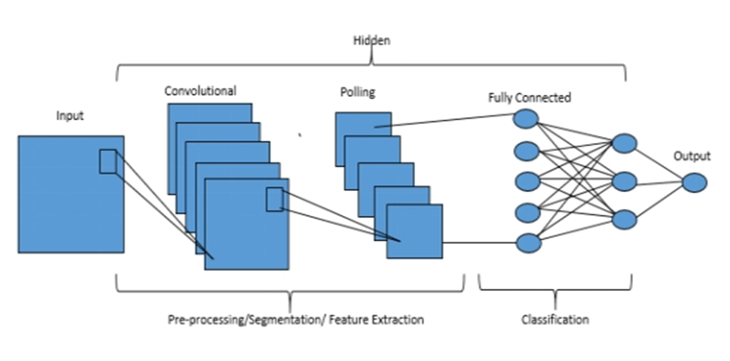
Figure 1. Schematic diagram of Convolutional Neural Network (CNN).

Slide 19
In developing the project, the following technology tools will be used: Python version 3.9 Tensorflow – a backend framework for running Keras Keras – a Python library for developing and evaluating deep learning models Streamlit – a Python library for developing custom web application for machine learning Html- a standard markup language for documents designed displayed in web browser CSS – a style sheet language use for describing the written document in HTML Jupyter – for editing and running documents that contains codes Necessary installations of libraries, packages and frameworks will be made in order for this project to be realized and to support the system to be suitable for identifying corn disease for which the trained model will be going to be deployed for actual implementation.
3.2 DETAILS OF THE TECHNOLOGIES TO BE USED

Slide 20
The project will be a Computer-Based application in which the user will provide and upload an image in a jpeg. / Jpg. / png. format that has a clear image of corn plant leaves on it. The pictures from leaf samples of corn are subjected to undergo image processing in which it's enhancing image data so that undesired distortions are suppressed and image features that are relevant for the further processing are emphasized. Next, the corn leaf image will undergo image segmentation where the region of interest will be partitioning into different parts according to their features and properties. Once the image is segmented, it will proceed to features extraction. The features such as color and texture which have to be analyzed were extracted from the image. This may be done to extract the region of interest from the corn leaf image. Using the extracted features, it will be then loaded to that training system which is utilizing Convolutional Neutral Network (CNN) machine learning algorithm. With the trained system it is then the system will be able to identify the type of disease based on the corn leaf image that is uploaded to the system.
3.2 HOW THE PROJECT WILLWORK

Slide 21
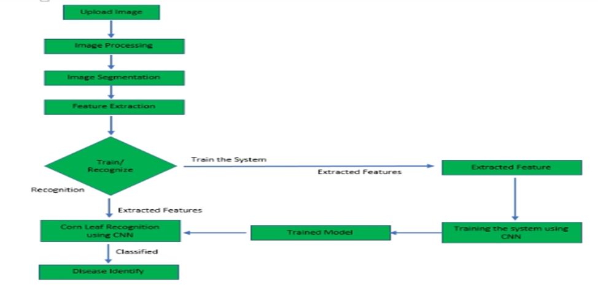
Figure 2. System architecture design of image-base corn disease identifier

Slide 22
CHAPTER 4
METHODOLOGY

Slide 23
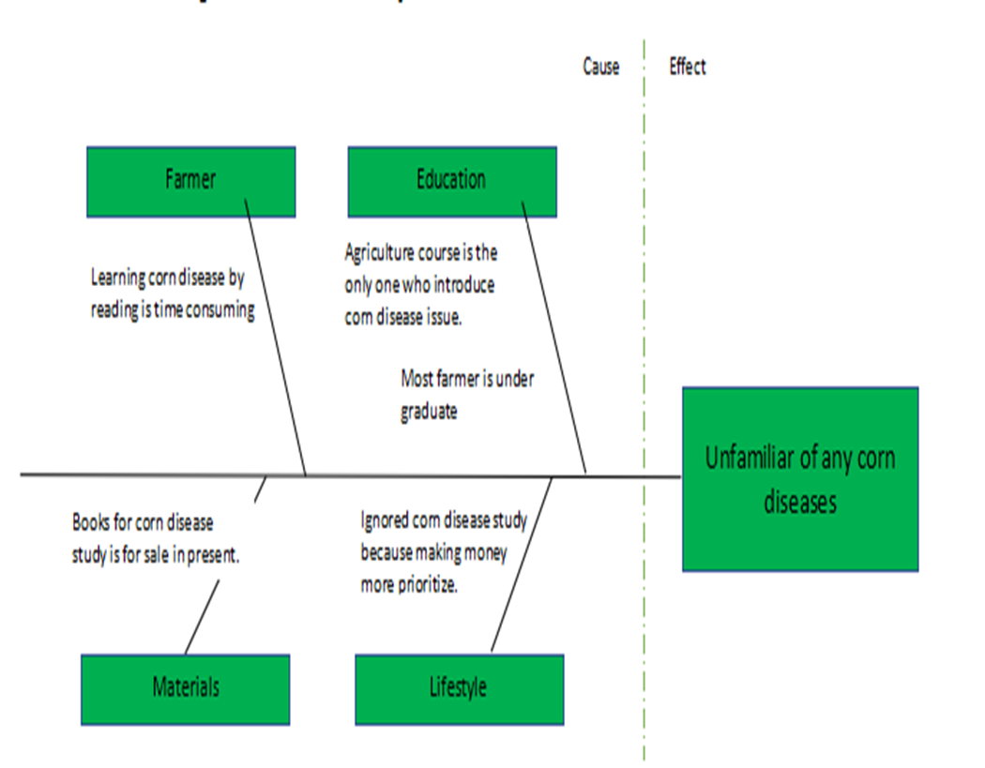
4.1 REQUIREMENTS SPECIFICATION
Figure 3. Fishbone Diagram

Slide 24
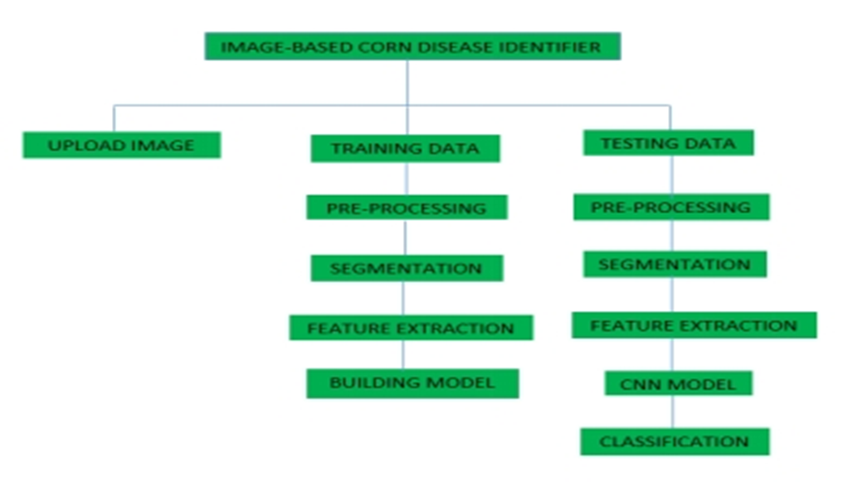
4.1 REQUIREMENTS SPECIFICATION
Figure 4. Function Decomposition Diagram

Slide 25
Capability Checking (Hardware and Software) The software in this study is a computer-based application that can be installed in any computer with Microsoft Operating System with a Windows version 7,8 and 10. The software can be runnable even without internet connection as long as all the needed software dependencies of the program is also installed in the computer. This system will need a third-party web cam or camera with a minimum of 720p resolution that will be used for capturing the input data. Relevance of Technology A computer is the most needed technology we can use in this system because this will be deployed in a computer-based application. Hence, all operations should be mainly done in the computer. Third party cameras or web cams can be used to capture high-definition images that we can use as our input data to the system so that we can generate a more accurate result.
4.1.2 TECHNICAL FEASIBILITY

Slide 26
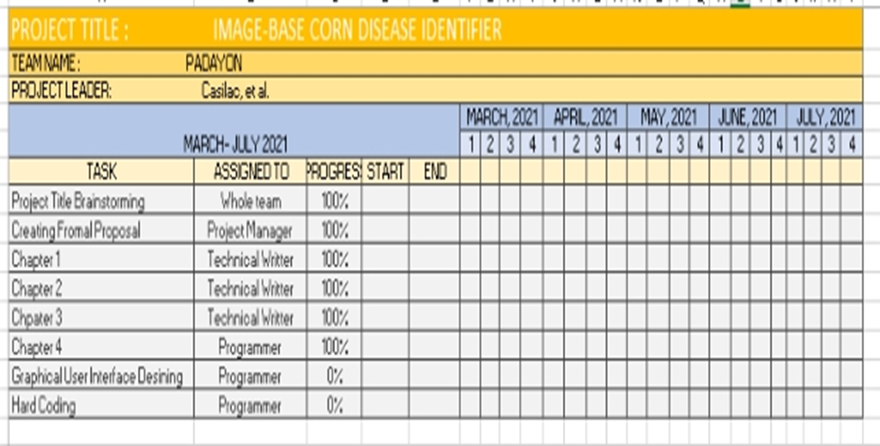
4.1.3 SCHEDULE FEASIBILITY
Figure 5. Gantt Chart

Slide 27
Capability Checking (Hardware and Software) The software in this study is a computer-based application that can be installed in any computer with Microsoft Operating System with a Windows version 7,8 and 10. The software can be runnable even without internet connection as long as all the needed software dependencies of the program is also installed in the computer. This system will need a third-party web cam or camera with a minimum of 720p resolution that will be used for capturing the input data. Relevance of Technology A computer is the most needed technology we can use in this system because this will be deployed in a computer-based application. Hence, all operations should be mainly done in the computer. Third party cameras or web cams can be used to capture high-definition images that we can use as our input data to the system so that we can generate a more accurate result.
4.1.2 TECHNICAL FEASIBILITY

Slide 28
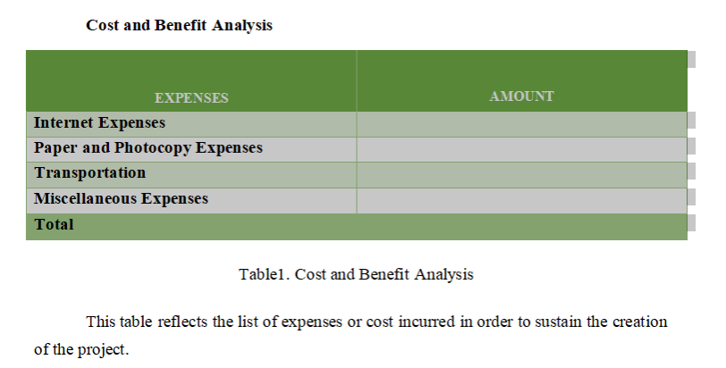
4.1.3 ECONOMIC FEASIBILITY

Slide 29
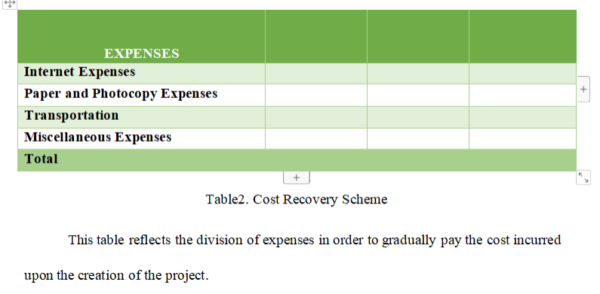
4.1.4 COST RECOVERY SCHEME

Slide 30
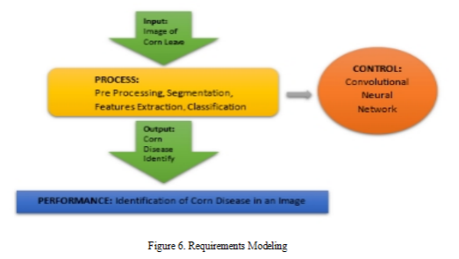
4.1.5 REQUIREMENTS MODELING

Slide 31
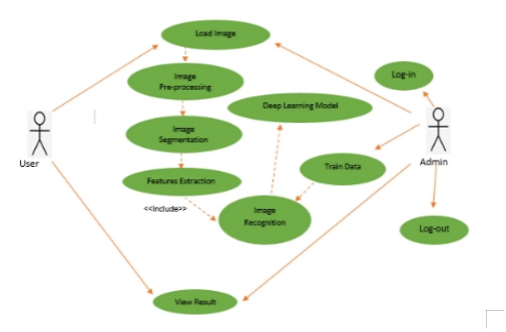
4.1.6 USE CASE DIAGRAM

Slide 32
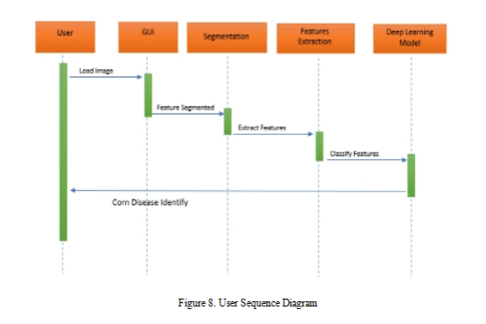
4.1.8 USER SEQUENCE DIAGRAM

Slide 33
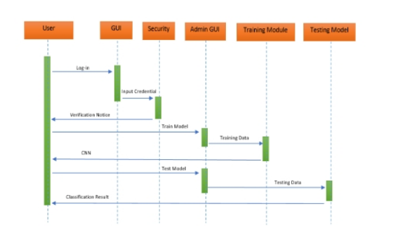
4.1.9 ADMIN SEQUENCE DIAGRAM

Slide 34
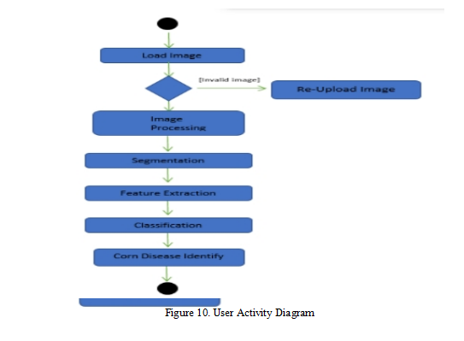
4.1.10 USER ACTIVITY DIAGRAM

Slide 35
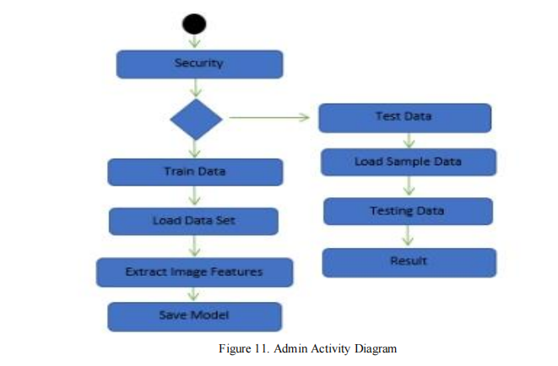
4.1.11 ADMIN ACTIVITY DIAGRAM

Slide 36
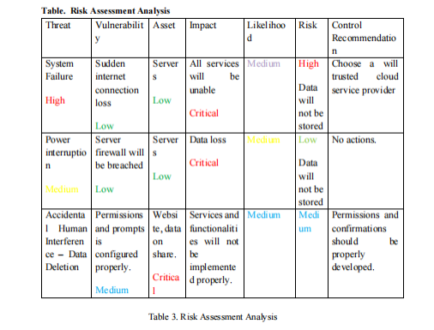
4.1.12 RISK ASSESMENT ANALYSIS

Slide 37
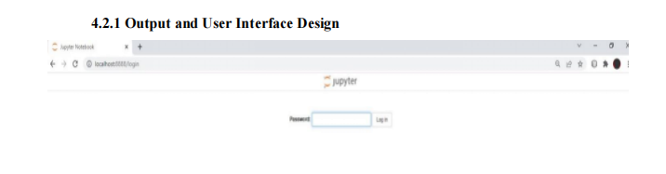
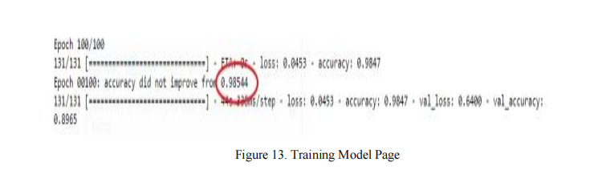
4.2 OUTPUT USER INTERFACE DESIGN
4.2 TRAINING MODEL PAGE

Slide 38
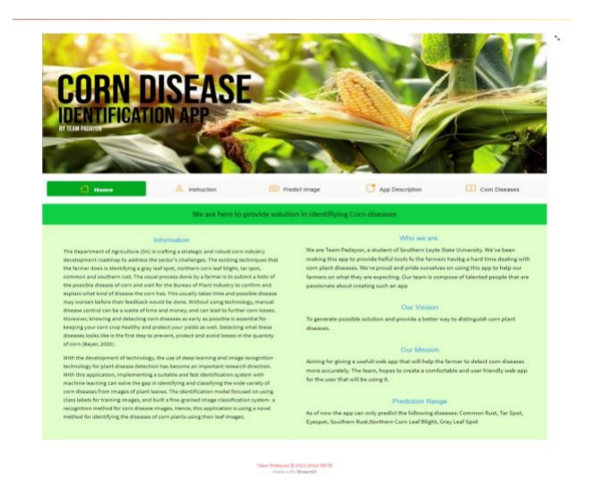
4.2 HOME PAGE
4.2 PREDICTION PAGE

Slide 39
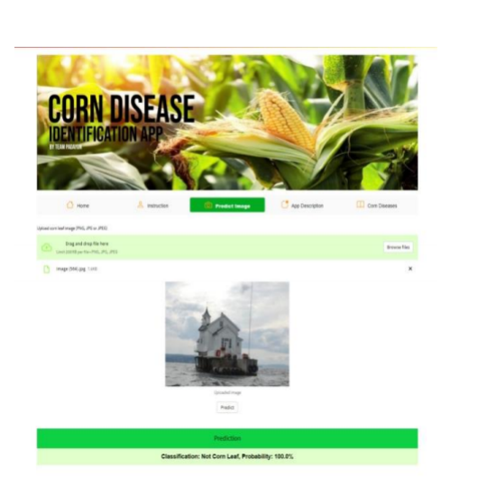
4.2 PREDICTION PAGE

Slide 40
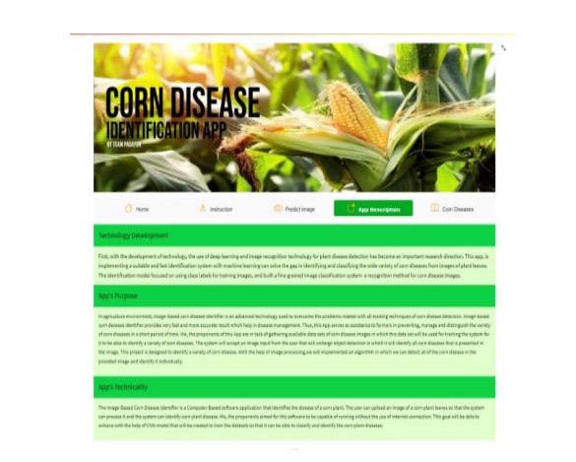
4.2 HOW THE PROJECT WILL WORK

Slide 41
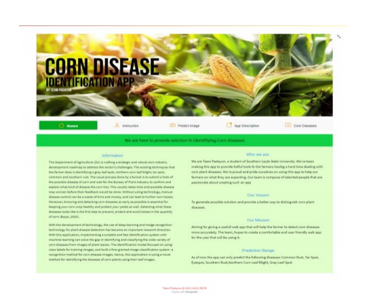
4.2 ABOUT

Slide 42
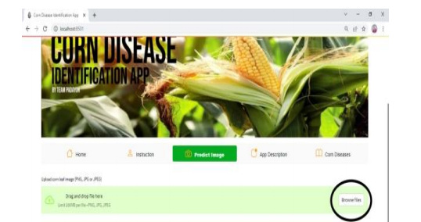
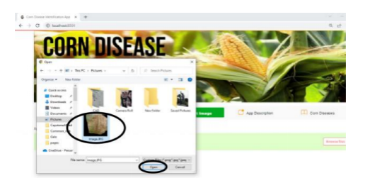
4.2 BROWSE IMAGE
4.2 SELECT

Slide 43
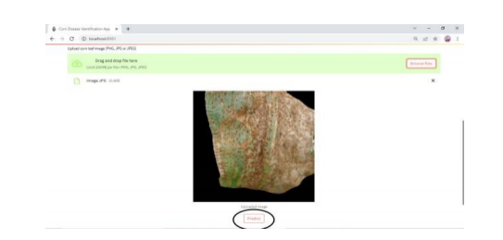
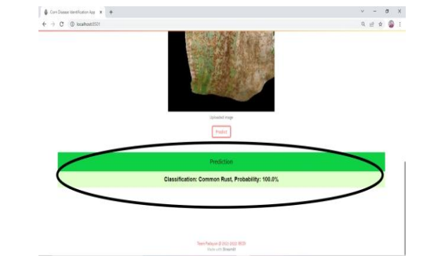
4.2 PREDICT BUTTON
4.2 PREDICTION OUTPUT

Slide 44
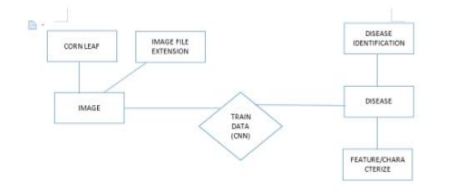
4.2 ENTITY RELATIONSHIP DIAGRAM

Slide 45
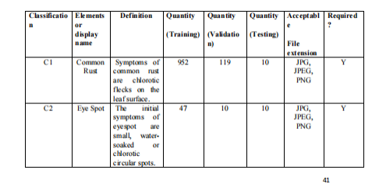
4.2 DATA DICTIONARY

Slide 46
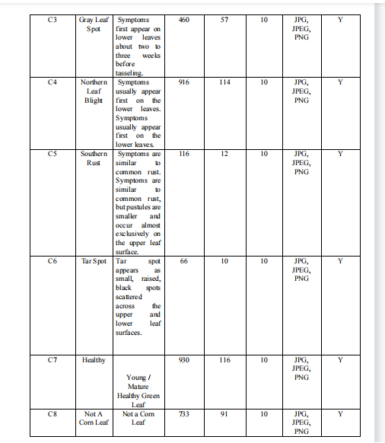
4.2 DATA DICTIONARY

Slide 47
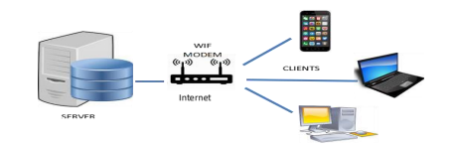
SYSTEM ARCHITECTURE 4.2.3 NETWORK MODEL

Slide 48
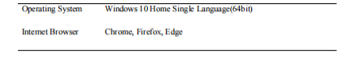
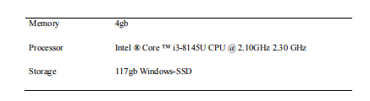
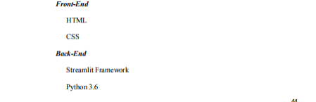
DEVELOPMENT 4.3 SOFTWARE SPECIFICATION
4.3 HARDWARE SPECIFICATION
4.3 PROGRAM SPECIFICATION

Slide 49
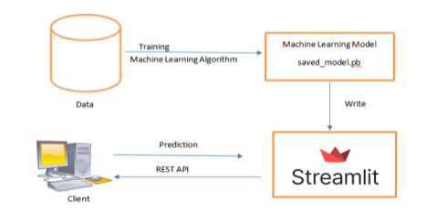
4.3.5 DEPLOYMENT PROGRAM

Slide 50
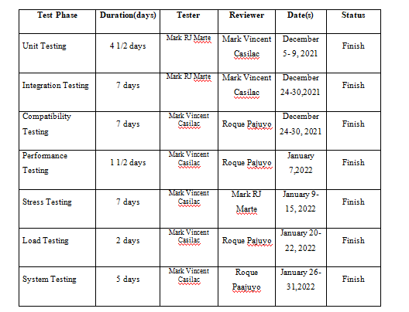
4.3.6 TEST PLAN

Slide 51
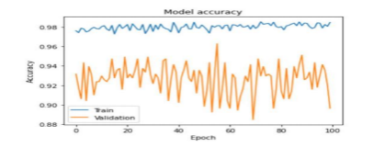
tested. The model was created using 4222 training images samples with 8 different classes from DateSet repository. It was combined together with 521 validation samples and trained for 100 epochs. The result of the training gained a total of 0.98544 or 98% highest training accuracy.
4.4.1 TECHNICAL FEASIBILITY

Slide 52
streamlit framework. The model was tested using random images from the 521 test samples, captured images from webcams and phone cameras. The result of the test was similar to the performance during the model evaluation and concluded that it was a successful integration to the GUI.
4.4.2 INTEGRATION TESTING

Slide 53
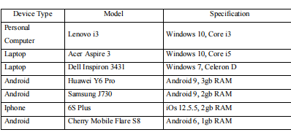
view web pages to monitor its capability to operate in different devices. The application was deployed in the following devices:
4.4.3 COMPATIBILITY TESTING

Slide 54
view web pages to monitor its capability to operate in different devices. The application was deployed in the following devices:
4.4.3 COMPATIBILITY TESTING

Slide 55
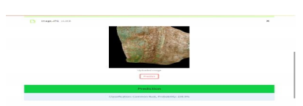
4.4.4 PERFORMANCE TESTING
internet with a common rust disease, the application was able to predict the disease with a 100% probability

Slide 56
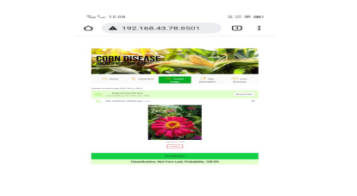
4.4.4 PERFORMANCE TESTING
taken from the phone camera and directly upload to the application. The application was able to predict that uploaded image is not a corn leaf with 100% probability.

Slide 57
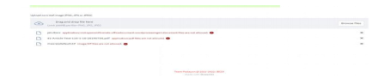
to test the capability of the system when it is used beyond its expected usage. The application only caters three file formats, PNG, JPG and JPEG. Hence, the application was tested using different file formats that was considered as an invalid input, the expected output was achieve by giving an error message that such a file is not allowed on the system.
4.4.5 STRESS TESTING

Slide 58
via local host network. The test was conducted using 8 different devices (clients) connected to a single MODEM/ WIFI connection, the test was successful, the response time between the computer server and the clients is fast and the result was given accurately as expected. And the application can identify either uploaded image was a corn leaf or not.
4.4.6 LOAD TESTING
The application was tested using six different methods, with all of the test was all successful, it can be concluded the overall system is successful. The application was deployed on a single desktop unit connected through a local host network, access it using web browsers on different devices and tested its capability to predict. The application was able to perform a result as expected.
4.4.7 SYSTEM TESTING

Slide 59
CONCLUSION AND RECOMMENDATION
things more accessible and easier. This system will bridge the gap between a traditional technique that the farmer does and the interest of using a advanced technology in identifying a corn disease. All the objectives of this study were successfully achieved. The system is able to identify a corn disease and the features were effective for recognizing a corn leaf disease. The study was able to develop a corn leaf disease recognizer with an accuracy 98.54%.

Slide 60
CONCLUSION AND RECOMMENDATION
However, this study has a lot of rooms for improvement, first is to further improve the performance of the classification model and also consider to include other currently discovered corn leaf diseases. The system developed in this study was only able to recognized 6 corn leaf diseases, and it can identify if the uploaded image is not a corn leaf. It is hereby recommended that the system include other corn leaf diseases

Slide 61
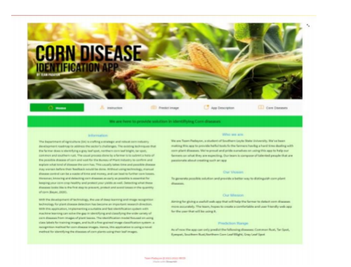
PROGRAM

Slide 62
THANK YOU

